Slide 1






MACHINE LEARNING
WILD-FIRE-DETECTION
ZARAAR MALIK

Slide 2
TABLE OF CONTENTS
Topic Introduction
Strengths of the Project
Weakness of the Project
Personal Contribution
Code Implementation
High-Level Architecture
Key Standard Libraries
Future Aim
01
02
03
04
05
06
07
08

Slide 3
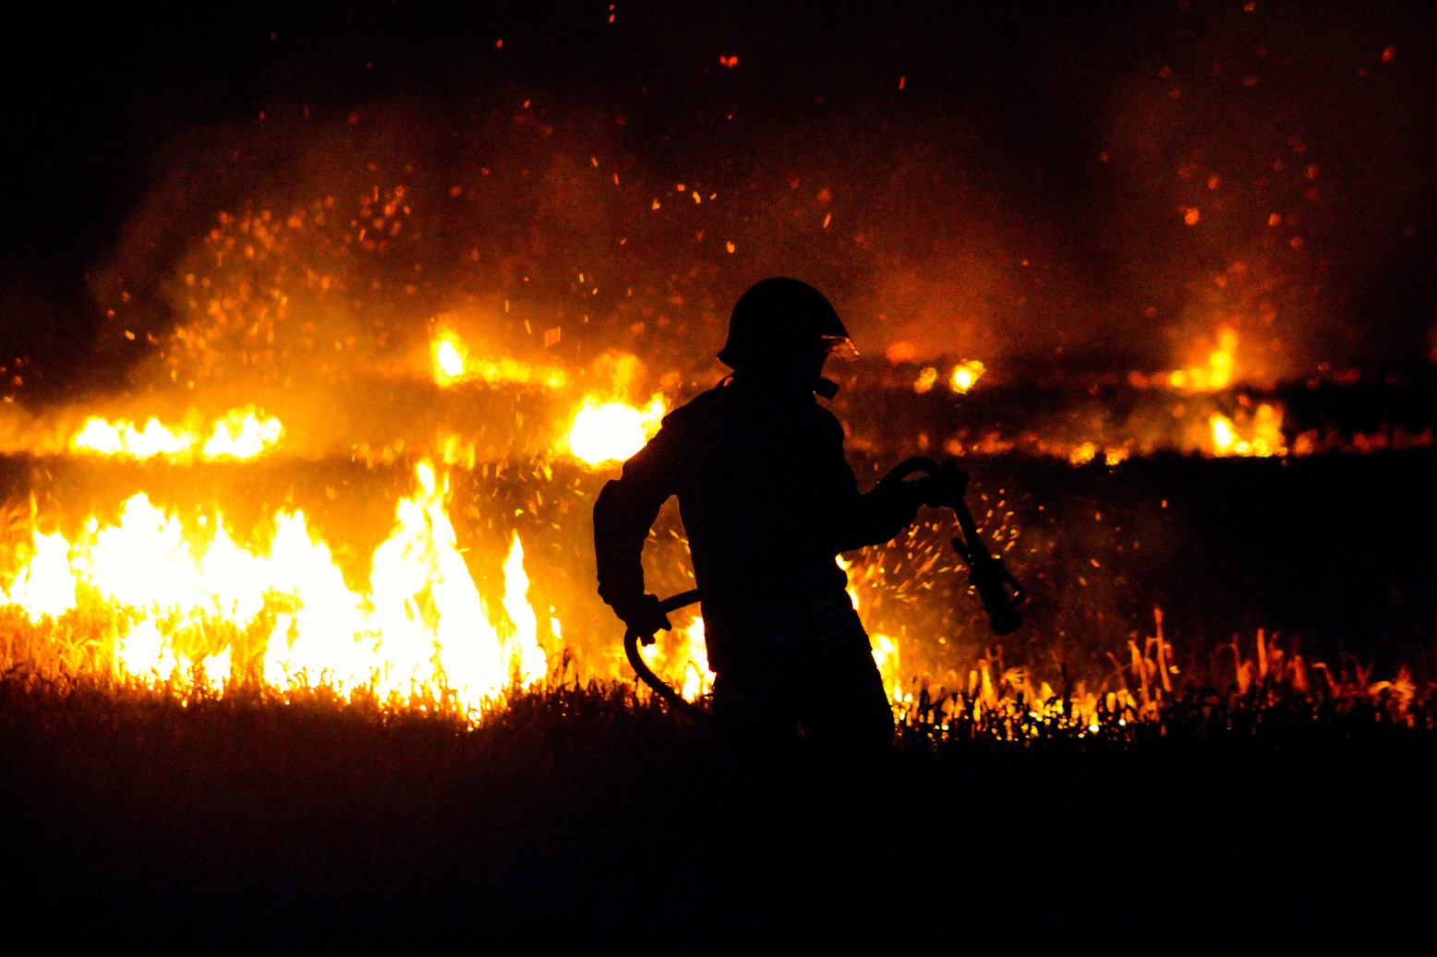
INTRODUCTION
In the face of escalating environmental challenges, early wildfire detection has emerged as a crucial safeguard. Utilizing cutting-edge technologies like AI and satellite imagery, these systems swiftly identify and monitor fire outbreaks, mitigating ecological and societal risks. This proactive approach represents a vital step in managing and minimizing the devastating impact of uncontrolled wildfires.
Machine Learning
Machine learning enhances wildfire detection by swiftly analyzing data, identifying patterns, and predicting outbreaks. This proactive approach allows for early intervention, minimizing ecological and human impact. ML's integration marks a crucial advancement in addressing the challenges of rapidly spreading wildfiresa.

Slide 4


STRENGTHS OF PROJECT
Customized Feature Extraction
Deployment and Interpretabillity
l In my approach, I manually extract statistical and fractional features, tailoring the feature set to the specific characteristics of wildfire images. This customization enhances my model's ability to capture domain-specific patterns and nuances related to fire detection.
I utilize a simple neural network with 5 layers, providing a straight forward and interpretable model. The simplicity of the architecture facilitates ease of understanding, interpretation, and deployment, making it valuable for stakeholders who require transparency in the decision-making process of my wildfire detection system.
Domain Specific Cues
Robustness to Noisy Environment
I integrate domain expertise into the feature extraction process, enabling the inclusion of features that are specifically relevant to the unique visual cues associated with wildfires. This incorporation ensures that the selected features align closely with the distinctive aspects of wildfire imagery, potentially improving my model's discriminative power.
My approach demonstrates robustness to noisy environmental conditions commonly encountered in wildfire scenarios. The manual extraction of features, combined with a simplified neural network, allows the model to focus on essential visual cues, making it more resilient to variations in lighting, weather, or other potential sources of noise.

Slide 5






WEAKNESS OF PROJECT
LEARNING HIERARCHIAL FEATURES
Manual feature extraction may limit the model's capacity to learn hierarchical representations of data.
FEATURE QUALITY
The success of your model heavily relies on the quality and relevance of the manually extracted statistical and fractional features.
COMPLEX SPATIAL PATTERNS
Manual feature extraction may struggle to capture complex spatial patterns in wildfire images, which are crucial for accurate detection. Unlike deep learning models designed for image-related tasks, your approach might not be highly effective
POTENTIAL OVERFITTING
The simplicity of the neural network architecture, combined with manual feature extraction, may increase the risk of overfitting, especially if the model is not adequately regularized.

Slide 6

PERSONAL CONTRIBUTION
COMPREHENSIVE FEATURE ENGINEERING
Statistical Features
HOG
HISTOGRAM
Local Binary Pattern
02
03
DECREASED MODEL COMPLEXITY
01
04
MORE FOCUS TOWARDS FEATURE EXTRACTION

Slide 7
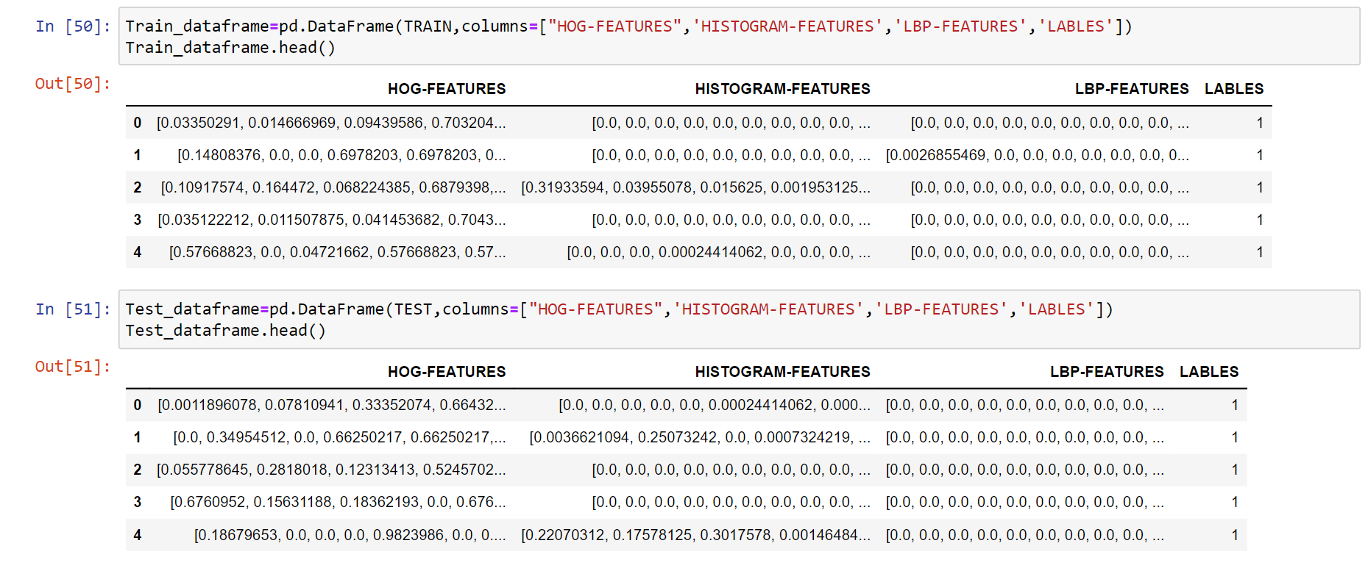
TRAIN AND TEST DATASETS

Slide 8
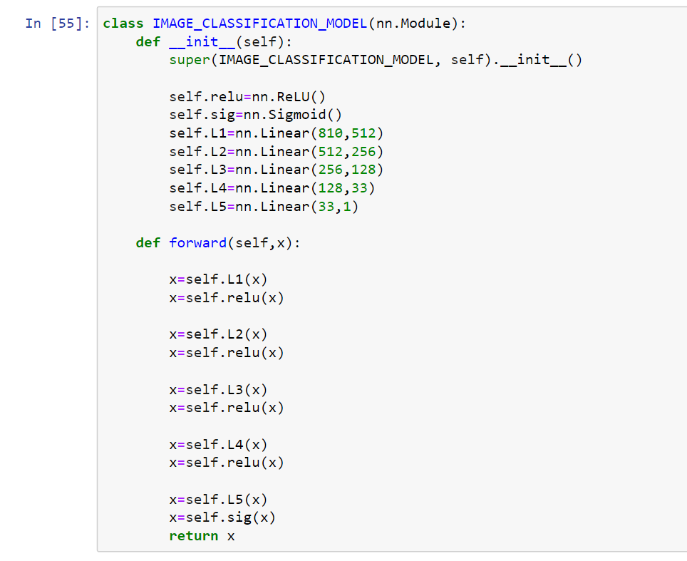
NEURAL NETWORK CLASS

Slide 9
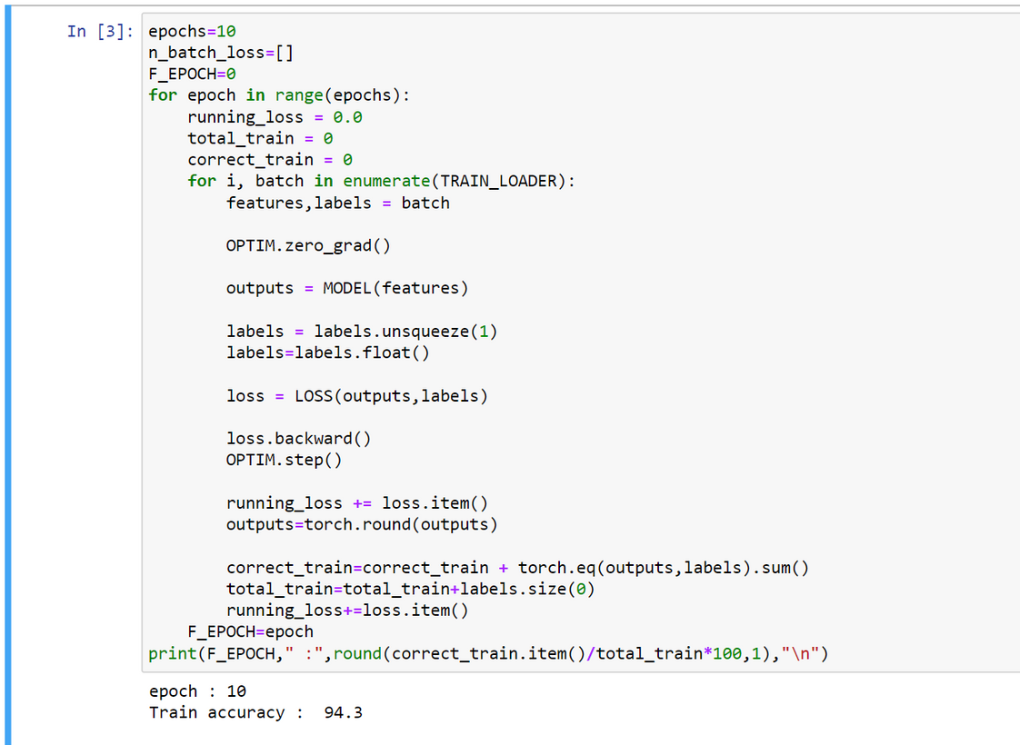
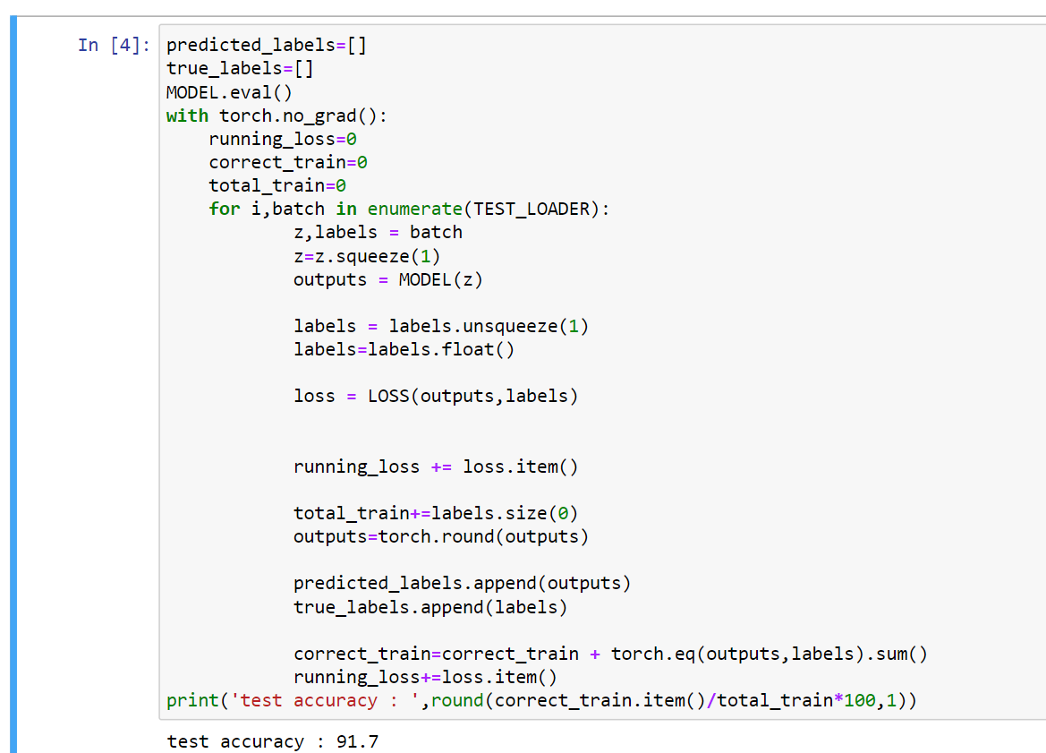
TRAINING AND TESTING ACCURACIES

Slide 10
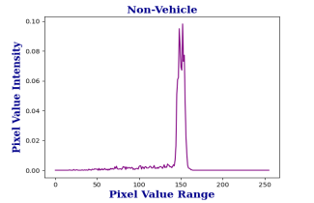
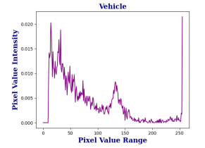
SOME EXTRACTED FEATURES
HISTOGRAM OF ORIENTED GRADIENTS

Slide 11
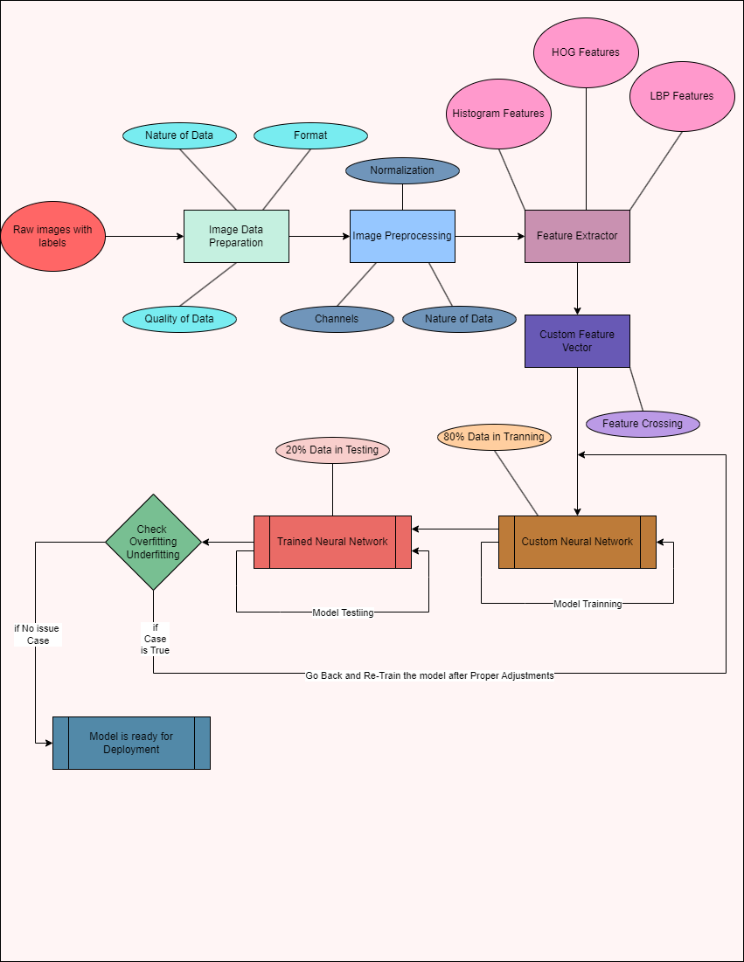


HIGH LEVEL
ARCHITECTURE

Slide 12
KEY STANDARD LIBRARIES
PANDAS (dataframe,head,tail)
NUMPY (array,resize,reshape)
PYTORCH (NN,tensor,Module)
SKLEARN (metrics,f1_score)
MATPLOTLIB (plot,show,subplot)
SKIMAGE (imread,imshow,features)

Slide 13


PROJECT SCOPE

Slide 14

THANK YOU!

